Slide 1
CSCI2100D Tutorial 3
Qintian GUO
Department of Systems Engineering and Engineering Management
Chinese University of Hong Kong

Slide 2
Outline
Basic Structures
Implementation of Linked List Functions

Slide 3
Outline
Basic Structures
Implementation of Linked List Functions

Slide 4
Linked List Definition
Stores a sequence of elements
It uses a node object to store each element
Each node further maintains:
A prev pointer that points to the address of the node storing the previous element
A next pointer that points to the address of the node storing the next element.
∅
3
4
5
head
tail
∅

Slide 5
Linked List Definition
1
2
3
4
5
typedef struct listNode {
int element;
struct listNode* prev;
struct listNode* next; }listNode;
1
2
3
4
typedef struct llist { listNode* head;
listNode* tail; }llist;
∅
3
4
5
head
tail
∅

Slide 6
Outline
Basic Structures
Implementation of Linked List Functions

Slide 7
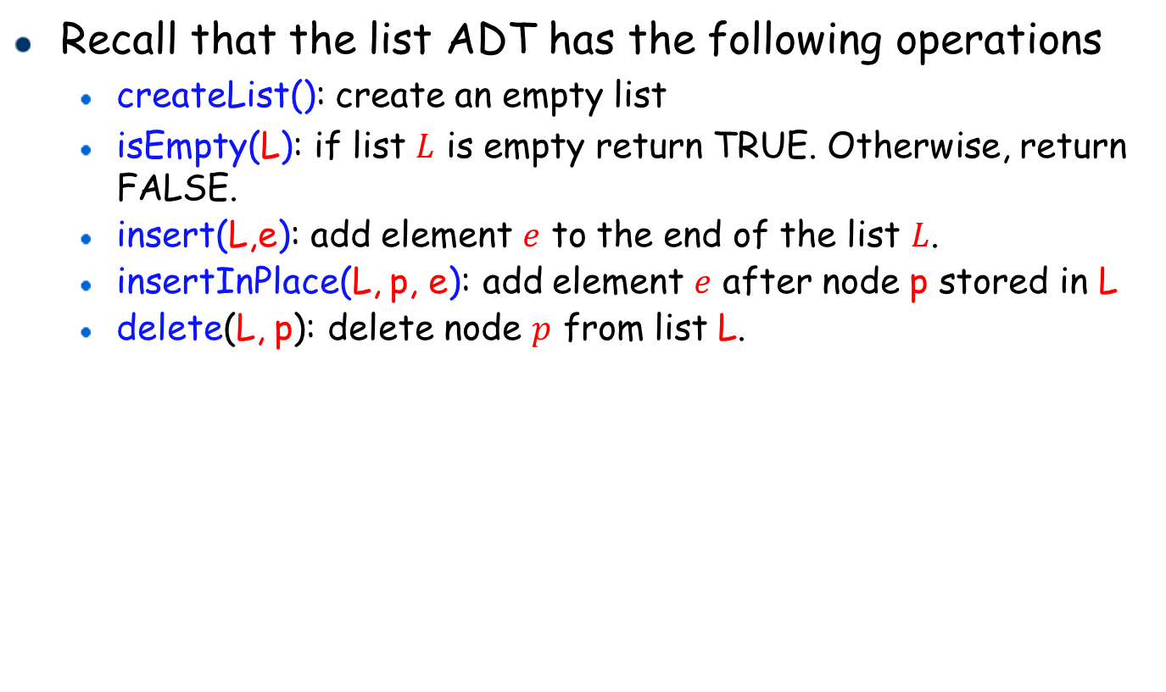
List ADT
Recall that the list ADT has the following operations
createList(): create an empty list
isEmpty(L): if list $L$ is empty return TRUE. Otherwise, return FALSE.
insert(L,e): add element $e$ to the end of the list $L$.
insertInPlace(L, p, e): add element $e$ after node p stored in L
delete(L, p): delete node $p$ from list L.

Slide 8
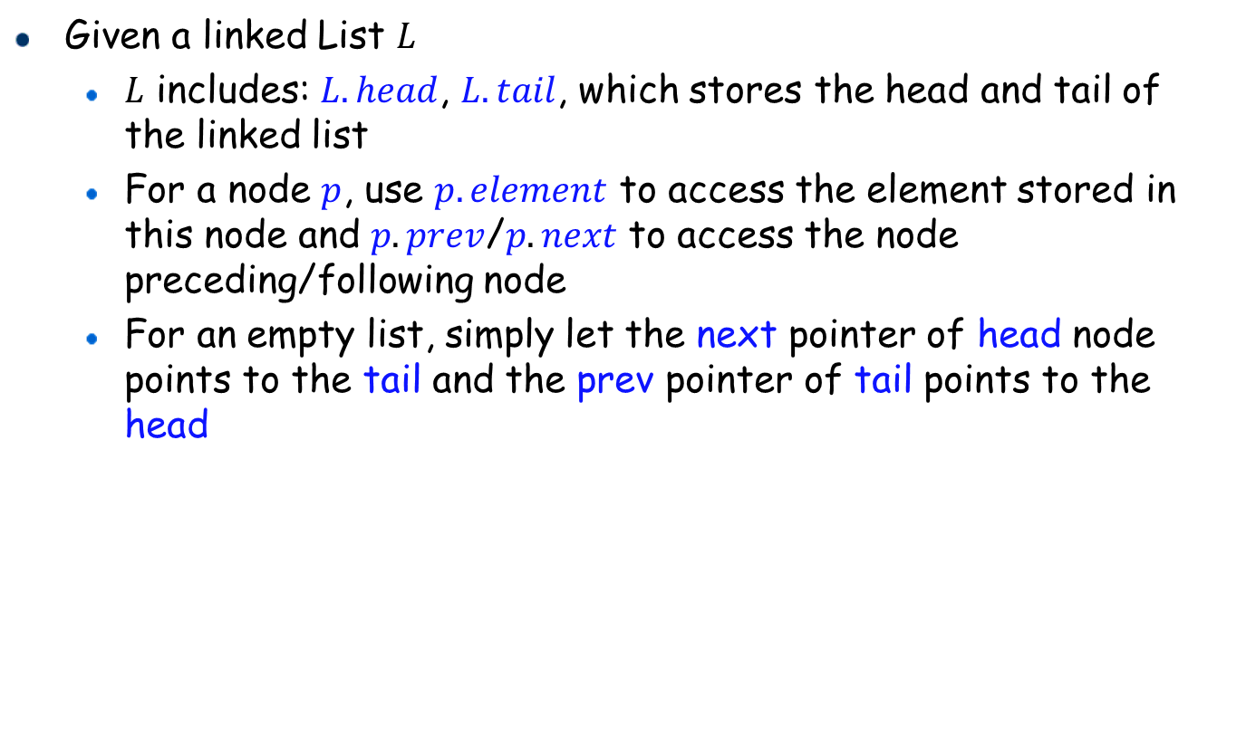
Create an Empty List
Given a linked List $L$
$L$ includes: $L.head$, $L.tail$, which stores the head and tail of the linked list
For a node $p$, use $p.element$ to access the element stored in this node and $p.prev$/$p.next$ to access the node preceding/following node
For an empty list, simply let the next pointer of head node points to the tail and the prev pointer of tail points to the head

Slide 9
Pseudo-code and C code
Algorithm: createList()
1
2
3
4
5
6
Allocate memory for list L
Allocate memory for node L.head and node L.tail
L.head.prev = NULL
L.head.next = L.tail
L.tail.prev = L.head
L.tail.next = NULL
1
2
3
4
5
6
7
8
9
10
11
12
13
14
15
16
llist* createList() {
// Allocate memory for List L, Nodes L.head and L.tail llist* L = (llist*)malloc(sizeof(llist));
listNode* head = (listNode*)malloc(sizeof(listNode));
listNode* tail = (listNode*)malloc(sizeof(listNode));
// Update each element
L->head = head;
L->tail = tail;
L->head->prev = NULL;
L->head->next = L->tail;
L->tail->prev = L->head;
L->tail->next = NULL;
L->head->element = -1;
L->tail->element = -1;
return L; }

Slide 10

Searching in Linked List
Assume that we have the linked list $L$
Use L.head.next to obtain the first node storing element
Use the next pointer of the first node to access the second node storing element, etc
Repeatedly access all the elements in an iterative manner until we reach the tail

Slide 11
Pseudo-code and C code
Algorithm: ListSearch(L, num)
1
2
3
4
5
6
node = L.head.next
while node != L.tail
if node.element == searchnum
return node
node = node.next
return NULL
1
2
3
4
5
6
7
8
9
10
11
12
// Search a linkedList to return the node of the element we are searching for
listNode* ListSearch(llist *L, int num) {
listNode * node = L->head->next;
while (node != L->tail) {
if (node->element == num) {
return node;
}
node = node->next;
}
return NULL;
}

Slide 12

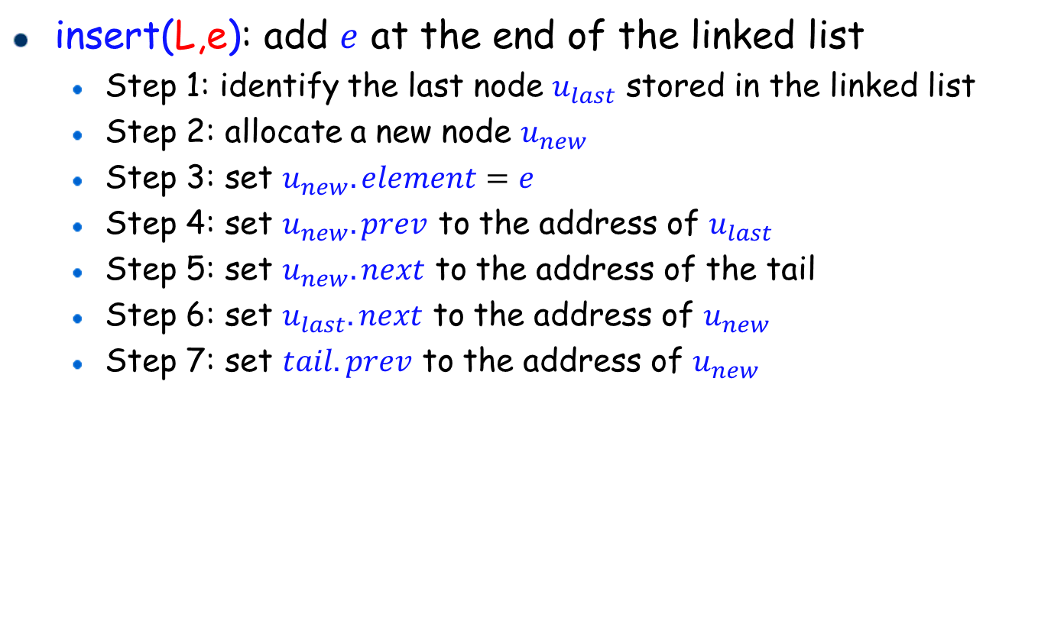

Insertion
insert(L,e): add $e$ at the end of the linked list
Step 1: identify the last node $u_{last}$ stored in the linked list
Step 2: allocate a new node $u_{new}$
Step 3: set $u_{new}.element=e$
Step 4: set $u_{new}.prev$ to the address of $u_{last}$
Step 5: set $u_{new}.next$ to the address of the tail
Step 6: set $u_{last}.next$ to the address of $u_{new}$
Step 7: set $tail.prev$ to the address of $u_{new}$
You may change the order of Steps 3-7
25
20
16
∅
head
$$u_{last}$$
tail
∅
e
$$u_{new}$$

Slide 13
Insertion: Pseudo-code and C code
Algorithm: insert(L, e)
1
2
3
4
5
6
7
Node ulast = L.tail.prev
Node unew <- allocate a new node from memory
unew.element = e
unew.prev = ulast
unew.next = L.tail
ulast.next = unew
L.tail.prev = unew
1
2
3
4
5
6
7
8
9
10
11
// Insert a node with Element e at the end of the linked list
void insert(llist *L, int e) {
listNode* ulast = L->tail->prev;
// Allocate a new node from memory
listNode* unew = (listNode*)malloc(sizeof(listNode));
unew->element = e;
unew->prev = ulast;
unew->next = L->tail;
ulast->next = unew;
L->tail->prev = unew;
}

Slide 14

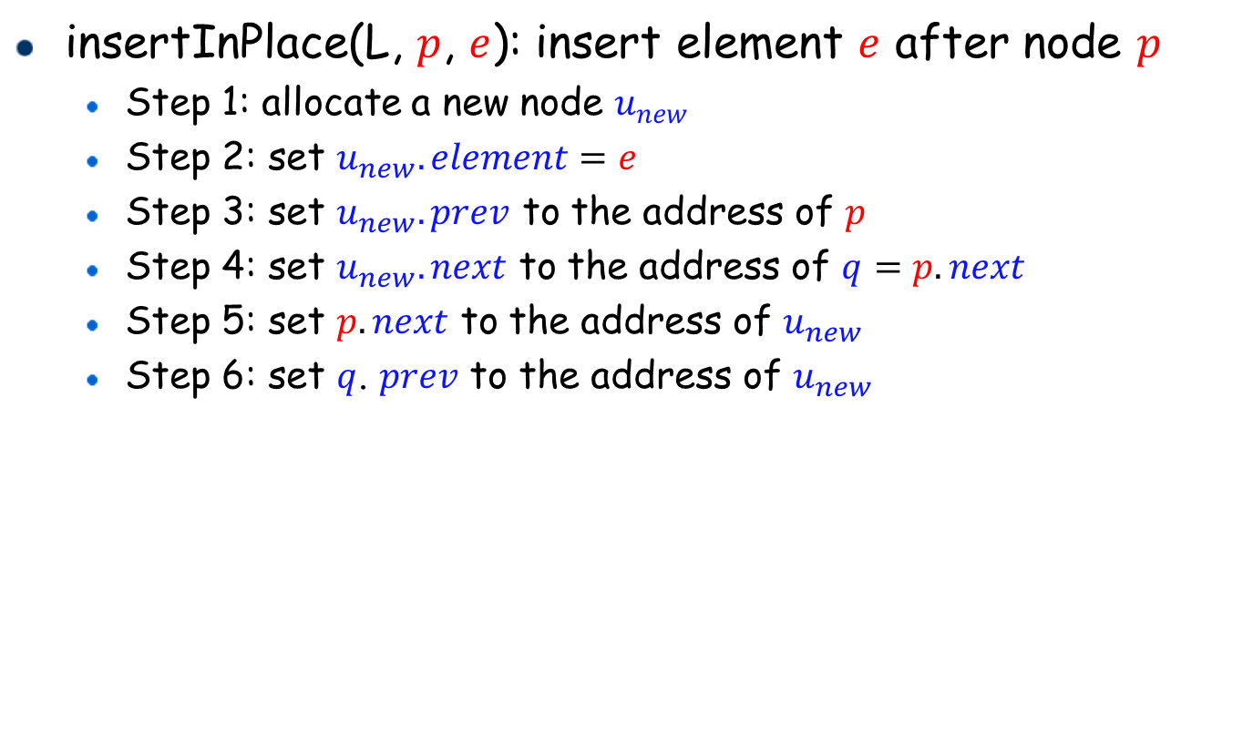


Insertion in Place
insertInPlace(L, $p$, $e$): insert element $e$ after node $p$
Step 1: allocate a new node $u_{new}$
Step 2: set $u_{new}.element=e$
Step 3: set $u_{new}.prev$ to the address of $p$
Step 4: set $u_{new}.next$ to the address of $q=p.next$
Step 5: set $p.next$ to the address of $u_{new}$
Step 6: set $q$. $prev$ to the address of $u_{new}$
16
20
25
∅
∅
head
tail
$$p$$
$$q$$
18
$$u_{new}$$

Slide 15
Pseudo-code and C code
Algorithm: insertInPlace(L, p, e)
1
2
3
4
5
6
7
Node unew <- allocate a new node from memory
unew.element = e
unew.prev = p
q=p.next
unew.next =q
p.next = unew
q.prev = unew
1
2
3
4
5
6
7
8
9
10
11
// Insert a node after Node p with Element e
void insertInPlace(llist *L, listNode* p, int e) {
// Allocate a new node from memory
listNode* unew = (listNode*)malloc(sizeof(listNode));
unew->element = e;
unew->prev = p;
listNode *q = p->next;
unew->next = q;
p->next = unew;
q->prev = unew;
}

Slide 16
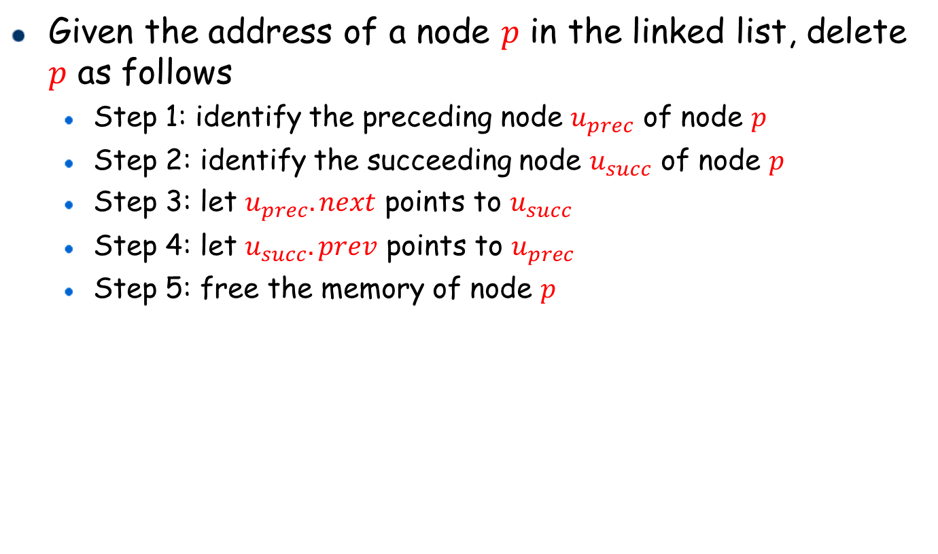


Deletion
Given the address of a node $p$ in the linked list, delete $p$ as follows
Step 1: identify the preceding node $u_{prec}$ of node $p$
Step 2: identify the succeeding node $u_{succ}$ of node $p$
Step 3: let $u_{prec}.next$ points to $u_{succ}$
Step 4: let $u_{succ}.prev$ points to $u_{prec}$
Step 5: free the memory of node $p$
16
25
∅
∅
head
tail
$$u_{prec}$$
$$u_{succ}$$
20
p

Slide 17
Deletion: Pseudo-code and C code
Algorithm: delete(L, p)
1
2
3
4
5
uprev = p.prev
usucc = p.next
uprev.next = usucc
usucc.prev = uprev
Free the memory of node p
1
2
3
4
5
6
7
8
// Delete Node p
void delete(llist* L, listNode* p) {
listNode* uprev = p->prev;
listNode* usucc = p->next;
uprev->next = usucc;
usucc->prev = uprev;
free(p);
}

